Slide 1
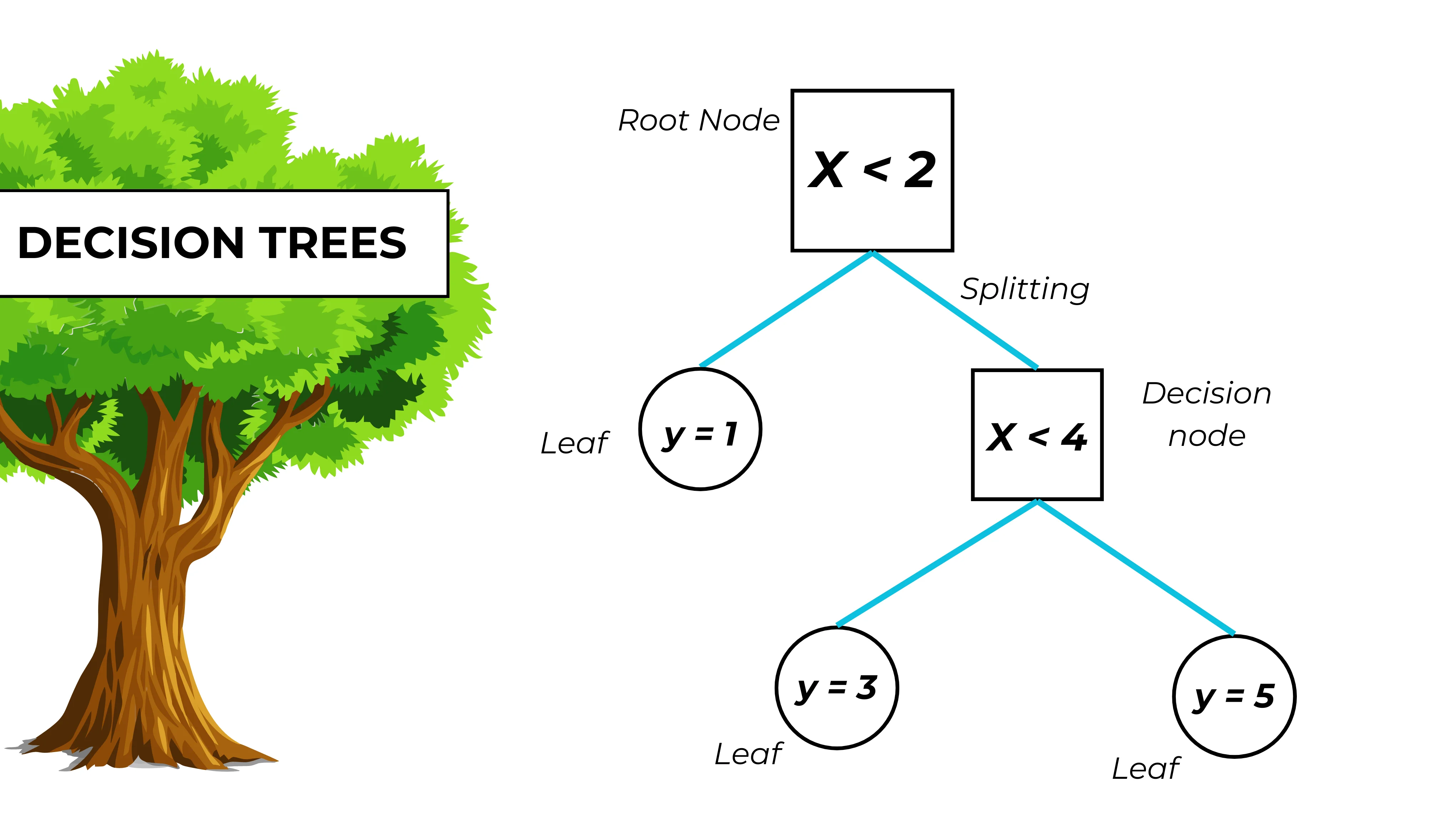
Decision Trees
Notes:
Source: https://www.youtube.com/watch?v=ZVR2Way4nwQ

Slide 2
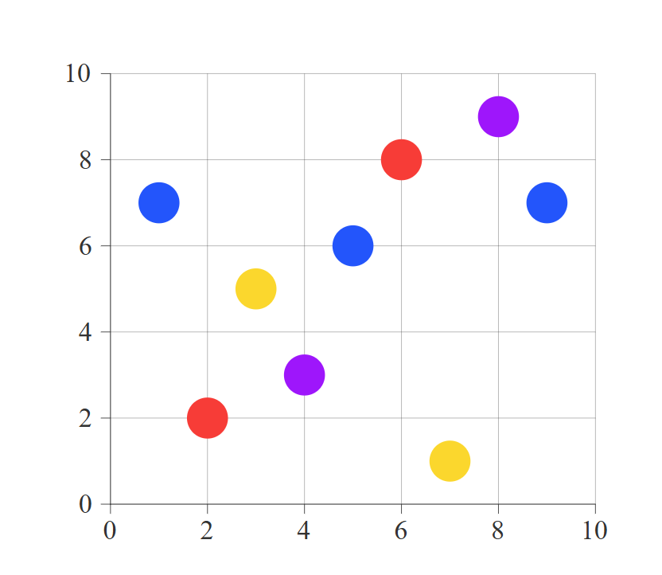
y
y
x
x
Notes:
We want to build up a decision tree there so we try different situations like x<=3 and x<=5

Slide 3

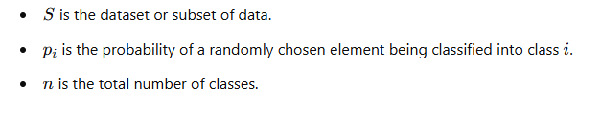

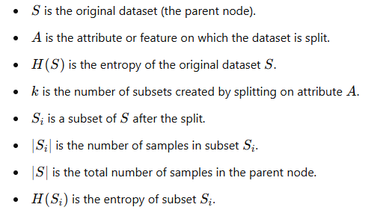


Step 1: Gini
Step 2: Information Gain

Slide 4
y
y
x
x

Slide 5
y
y
x≤3.5
Left
Right
x
x

Slide 6
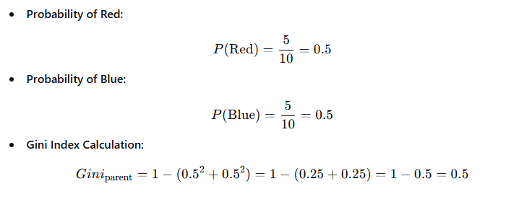
Step 1: Gini Parent
Parent:
x≤3.5
Left
Right

Slide 7
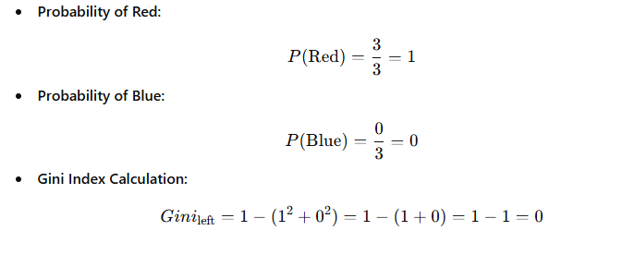
Step 1: Gini Left
Left:
x≤3.5
Left
Right

Slide 8
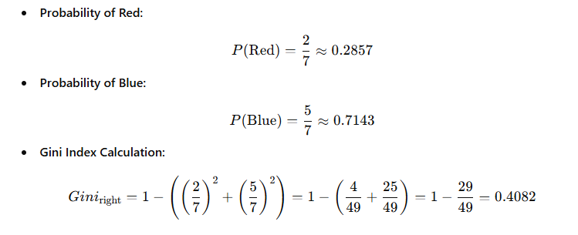
Step 1: Gini Right
Right:
x≤3.5
Left
Right

Slide 9
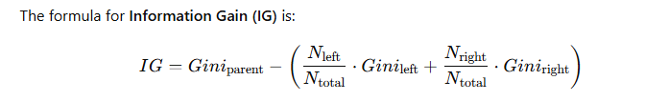


Step 2: Information Gain for x≤3
x≤3.5
Left
Right

Slide 10
y
y
x≤5
Left
Right
x
x

Slide 11
Step 1: Gini Parent
Parent:
x≤5
Left
Right

Slide 12
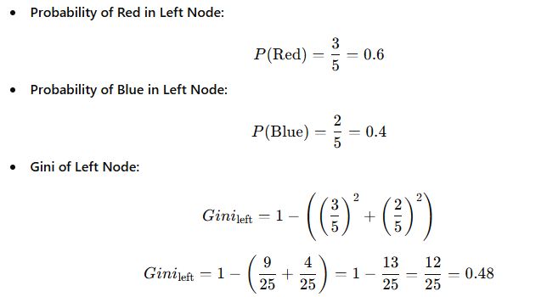
Step 1: Gini Left
Left:
x≤5
Left
Right

Slide 13
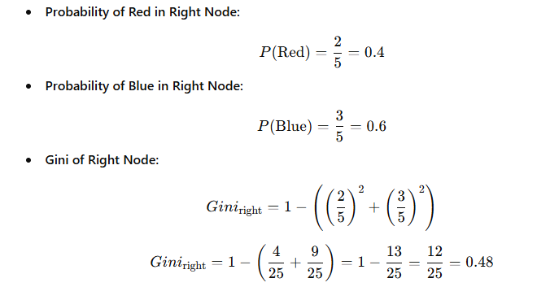
Step 1: Gini Right
Right:
x≤5
Left
Right

Slide 14
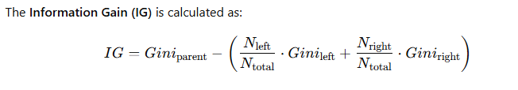


Step 2: Information Gain for x≤5
x≤5
Left
Right

Slide 15
Which first split will the algorithm choose?
Information Gain: 0,2143
Information Gain: 0,02
x≤3
x≤5
Left
Right
Left
Right
Notes:
Keep in mind the higher the information gain the better.

Slide 16
What is the depth of this three?
x <= 3.5
Samples: 10
Gini: 0.5
Value: [5,5]
Class: BLue
Samples: 3
Gini: 0.0
Value: [0,3]
Class: Red
x <= 6.5
Samples: 7
Gini: 0.41
Value: [5,2]
Class: BLue
x <= 5.5
Samples: 4
Gini: 0.5
Value: [2,2]
Class: BLue
Samples: 3
Gini: 0.0
Value: [3,0]
Class: BLue
y <= 4.5
Samples: 3
Gini: 0.44
Value: [2,1]
Class: BLue
Samples: 1
Gini: 0.0
Value: [0,1]
Class: Red
Samples: 1
Gini: 0.0
Value: [1,0]
Class: BLue
x <= 4.5
Samples: 2
Gini: 0.5
Value: [1,1]
Class: BLue
Samples: 1
Gini: 0.0
Value: [0,1]
Class: Red
Samples: 1
Gini: 0.0
Value: [1,0]
Class: BLue

Slide 17
# Adjusting the counts for the new dataset with an extra red dot at (6, 4)
# Total points now: 10 (5 red, 5 blue)
total_points_new = 10
# Updated class distribution in the dataset (Parent node)
counts_parent_new = {"red": 5, "blue": 5}
probabilities_parent_new = [count / total_points_new for count in counts_parent_new.values()]
# Entropy and Gini for parent node (with the new point added)
H_S_new = entropy(probabilities_parent_new)
Gini_S_new = gini(probabilities_parent_new)
# Split at x = 3 (with updated counts)
# Left subset: 2 red, 0 blue (no change)
# Right subset: 3 red, 5 blue
counts_left_3_new = {"red": 2, "blue": 0}
counts_right_3_new = {"red": 3, "blue": 5}
probabilities_left_3_new = [count / 2 for count in counts_left_3_new.values()]
probabilities_right_3_new = [count / 8 for count in counts_right_3_new.values()]
H_left_3_new = entropy(probabilities_left_3_new)
H_right_3_new = entropy(probabilities_right_3_new)
Gini_left_3_new = gini(probabilities_left_3_new)
Gini_right_3_new = gini(probabilities_right_3_new)
# Information gain for split at x = 3 (new data)
IG_3_new = H_S_new - (2/10 * H_left_3_new + 8/10 * H_right_3_new)
# Split at x = 5 (with updated counts)
# Left subset: 3 red, 2 blue (no change)
# Right subset: 2 red, 3 blue (one additional red point added)
counts_left_5_new = {"red": 3, "blue": 2}
counts_right_5_new = {"red": 2, "blue": 3}
probabilities_left_5_new = [count / 5 for count in counts_left_5_new.values()]
probabilities_right_5_new = [count / 5 for count in counts_right_5_new.values()]
H_left_5_new = entropy(probabilities_left_5_new)
H_right_5_new = entropy(probabilities_right_5_new)
Gini_left_5_new = gini(probabilities_left_5_new)
Gini_right_5_new = gini(probabilities_right_5_new)
# Information gain for split at x = 5 (new data)
IG_5_new = H_S_new - (5/10 * H_left_5_new + 5/10 * H_right_5_new)
(H_S_new, Gini_S_new, H_left_3_new, H_right_3_new, Gini_left_3_new, Gini_right_3_new, IG_3_new,
H_left_5_new, H_right_5_new, Gini_left_5_new, Gini_right_5_new, IG_5_new)

